Slide 1
Cable Based
Parallel Robots
(CDPR)
Saumil Shah

Slide 2
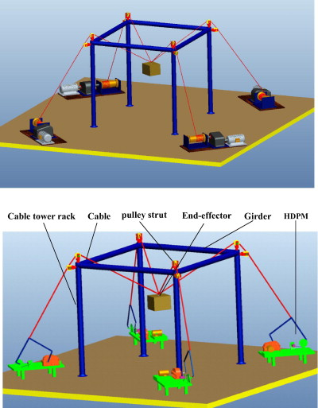
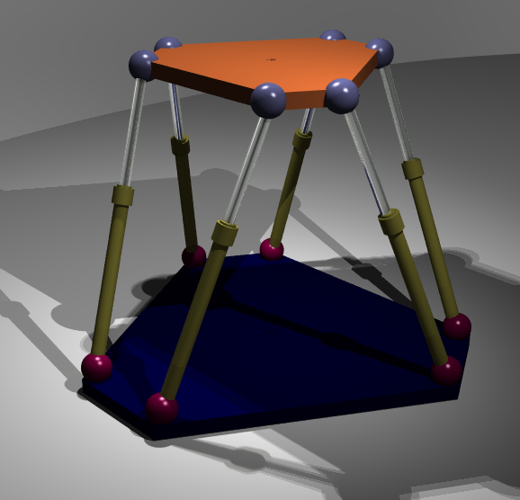
CDPR - Description
CDPR is a closed loop chain structure
Cables replaced with linear actuators
6 DOF Stewart-Gough parallel manipulator
CDPR in action

Slide 3
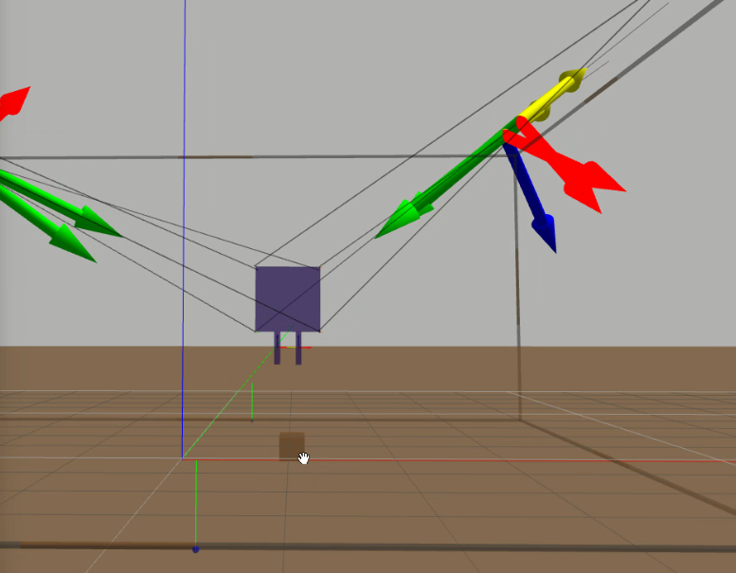
Simulation Environment
Entire model was created in Gazebo
Size of end effector - [ l , b , h ] = [ 0.6 m, 0.6 m, 0.6 m]
Size of outer frame - [ l , b , h ] = [ 3.5 m, 3.5 m, 3.5 m]
Parallel gripper used
Friction applied only on gripper plates ( friction coefficient = 1 )
Cables modeled as rigid rods

Slide 4
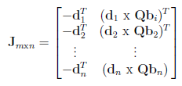
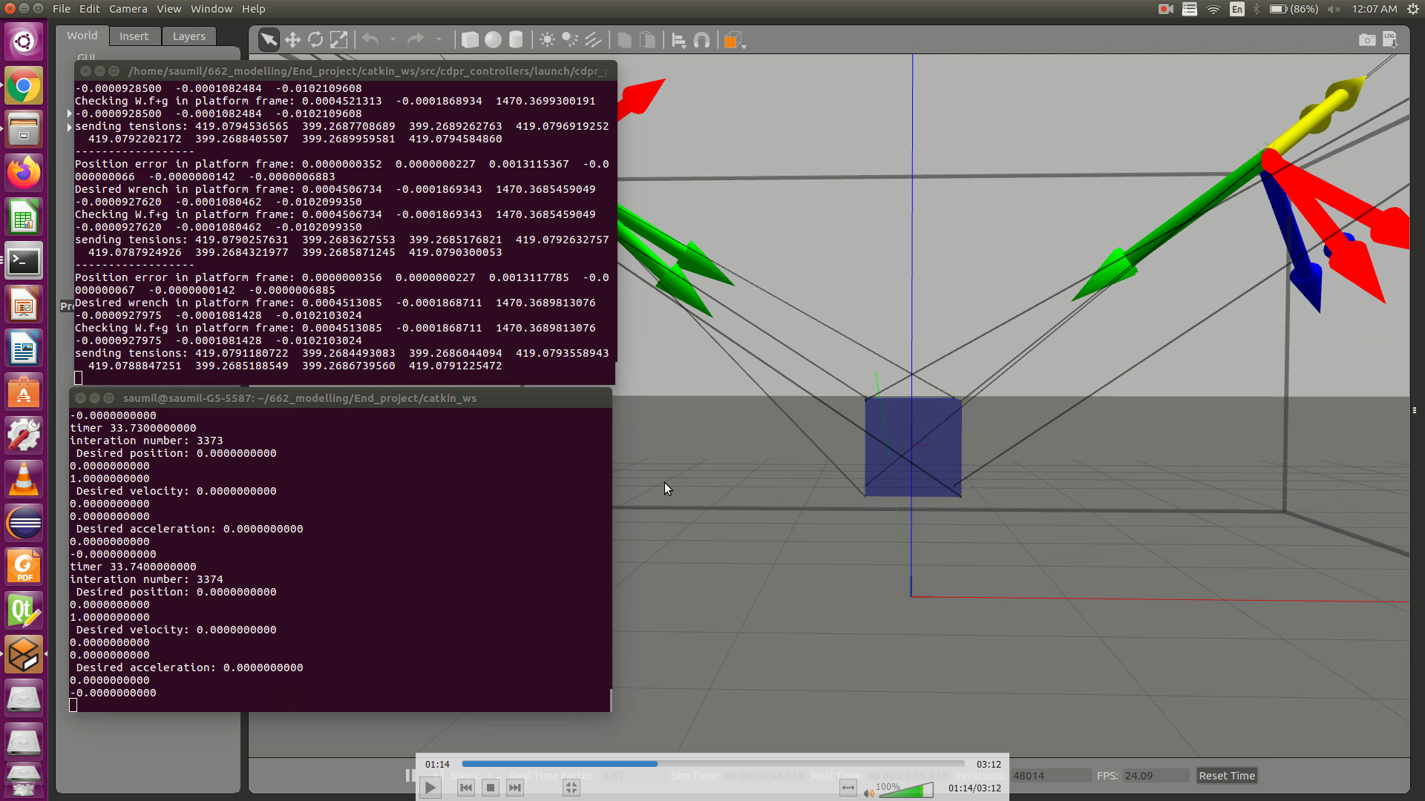
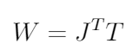
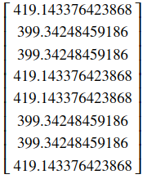
Quasi Static Analysis
Motor torques required can be directly calculated with the tensions created in the cables.
Tensions in the cables can be calculated with the help of virtual work method and the jacobian.
Value of tensions present in each cable
while stated at (x,y,z) = (0,0,1)
Calculated with jacobian
Value of tensions present in each cable while stated at (x,y,z) = (0,0,1)
Calculated by simulator

Slide 5
Gripping
As per the friction cone, total of 10 N force is required to pick up an one kg block.
For verification, 5 N force was applied to both the gripper plates.
6 N force applied to each gripper. Just sufficient enough
To pick up an object
5 N force applied to each gripper. Not sufficient and object slips.

